Slide 1

Java Library Management System with MySQL Integration
Console-based application using Java and MySQL for efficient library operations

Slide 2

Project Overview
Features
Technology Stack
Architecture
Book tracking and inventory
Java programming language
Layered design for modularity and maintenance
User management and authentication
MySQL database
JDBC for connectivity
Borrowing and return processes

Slide 3

Project Setup
Install JDK
Configure your IDE for Java development
Setup MySQL
Create database and user accounts
Include Dependencies
MySQL Connector/J
Java Time API for date handling

Slide 4
Project Structure
Model Layer
Service Layer
Main & DAO
Book.java
Library.java handles business logic
LibraryManagement.java (Main)
User.java
DatabaseConnection.java (DAO)

Slide 5
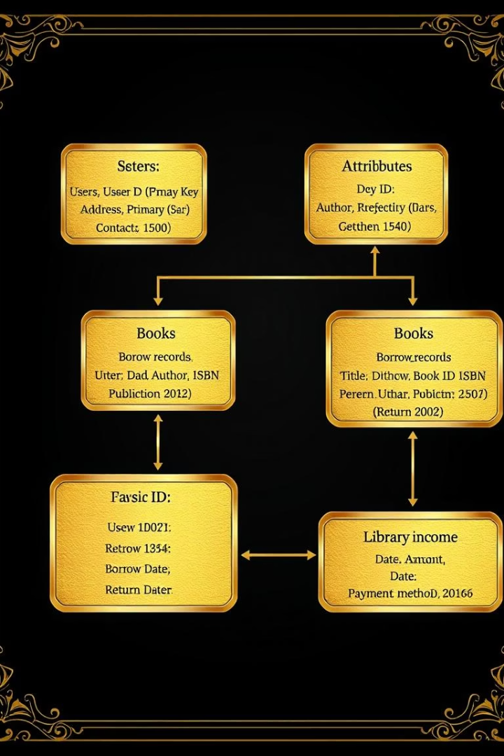
Database Design
Users Table
Stores student and librarian info
Books Table
Inventory with book details
Borrow Records
Transaction history and status
Library Income
Tracks fines and payments

Slide 6
CRUD Operations & JDBC Connectivity
CRUD Actions
JDBC Features
Create: Add books/users
Connection pooling for efficiency
Read: Search and filter
Prepared statements to prevent SQL injection
Update: Borrow & return books
Transaction management for consistency
Delete: Remove books

Slide 7
Layered Architecture & Input Validation
Layered Design
Input Validation
Presentation: Console UI
Usernames and passwords validated
Service: Business logic
Aadhaar: exact 12 digits
Data Access: JDBC operations
Phone Numbers: 10 digits format
Database: MySQL
Gender selection from limited options

Slide 8
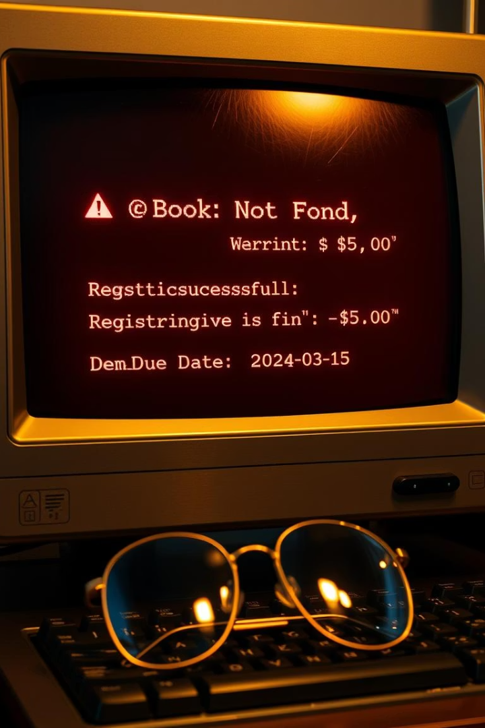



Error Handling, Demo, Next Steps
Error Handling
Clear messages for user guidance
Overdue fine alerts
Input validation feedback
Demo Highlights
Book listing interface
User registration flow
Borrow and return process
Future Enhancements
Web-based interface development
Email notifications for users
Barcode scanner integration

Slide 9
